Slide 1
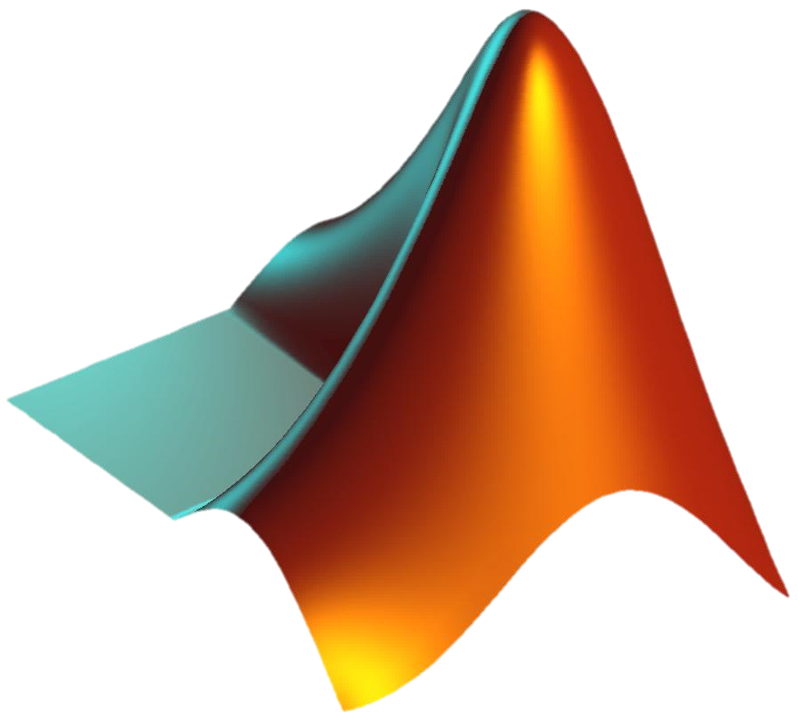
MATLAB WORKSHOP
Part 4: Advanced topics

Slide 2
Content
Symbolic variables
Symbolic functions
Solving ordinary equations
Solving differential equations
Fitting to a polynomial
Function handles
MATLAB GUI

Slide 3
Symbolic variables
Motivation
So far we worked with vectors, and functions acting on vectors and returning vectors.
In many cases we are interested in the function itself and want to manipulate and analyze it
For this reason MATLAB allows us to define symbolic variables and symbolic functions that are defined on these variables
Definitions
A symbolic variable will be defined using the sym command.
For example, defining a symbolic variable a and a positive symbolic variable b:
a = sym(‘a’);
b = sym(‘b’ , ‘positive’);

Slide 4
Symbolic variables
Definitions
We can use the syms command which is equivalent to sym
For example: defining symbolic variables x,y and z
Using the assume command we can define conditions on the variables
Using the assumptions command we can get the current set of assumptions.
syms x y z
assumptions % Empty sym: 1-by-0
assume(y, 'real') ;
assumptions % y in R_
assume(x>1);
assumptions % [ 1 < x, y in R_]

Slide 5
Symbolic variables
Definitions
Symbolic function definition will be done similarly to writing a normal function, only instead of a vector, we will run the function on a symbolic variable. For example:
To access values instead of the symbolic variables, we can explicitly specify which variables the function is running on
The findsym function gives all variables of a symbolic function
f1 = exp(2*x)*sin(3*y);
f2(x,y) = exp(2*x)*sin(3*y);
f3(x) = exp(2*x)*sin(3*y);
f3(1) % will give the answer exp(2)*sin(3*y) which is a function of y
findsym(f1) % x,y
findsym(f2(a,1)) % a

Slide 6
Symbolic variables
Definitions
Substituting numerical values in the functions can be done by:
1. Substituting the values as an input to the symbolic function:
2. The command subs
3 The command subs with predefined symbolic variables:
f4(x,y) = exp(x)*(y^2-1);
f4(1,2) % exp(1)*3
double(f4(1,2)) % 8.1548
double(subs(f4,[x, y],[1,2])) % 8.1548
x=1; y=2;
double(subs(f4)) % 8.1548

Slide 7
Symbolic variables
Definitions
The command double changes an answer from symbolic to scalar.
subs can be also used to replace symbolic expressions:
For example:
subs(symbolic function, old expression, new expression)
f2(x,y) = exp(2*x)*sin(3*y);
subs(f2, exp(2*x), cos(x)+1) % (cos(x)+1)*sin(3*y)

Slide 8
Symbolic variables
Actions on symbolic functions
Function | Action of the function
simplify | Simplifying symbolic expressions
diff | Taking the derivative
int | Calculating an integral
limit | Calculating limit
fourier | Calculating Fourier transformation
laplace | Calculating Laplace transformation
taylor | Taylor expansion
solve | Solving algebraic equation (set of equations)
dsolve | Solving differential equation (set of equations)

Slide 9
Symbolic variables
simplify
Symbolic function simplification:
Example:
Simplifying function in N steps:
Example:
The number of steps N depends on the function inside algorithm…
simplify(symbolic function)
simplify( (cos(x))^2 - (sin(x))^2 ) % cos(2*x)
simplify(symbolic function, N)
f(x) = exp(1i*x) / cos(x) - 1 ;
simplify( f ) % (sin(x)*i)/cos(x)
simplify( f , 50 ) % tan(x)*i

Slide 10
Symbolic variables
diff
Calculation of derivative:
Example:
Calculation of the n-order derivatives:
Example:
diff(symbolic function)
f = x*exp(x);
df_dx = diff(f) % exp(x) + x*exp(x)
diff(symbolic function, n)
d7y_dx7 = diff(f,7) % 7*exp(x) + x*exp(x)

Slide 11
Symbolic variables
int
Non-specific integral calculation:
Example:
Calculating a particular integral:
Example:
int(symbolic function)
f = 1/x ;
int(f) % log(x)
int(symbolic function, symbolic variable, minimum value, maximum value)
int(f, 'x’, 1, 2*pi) % log(2*pi)
int(f, 'x’, 1, sin(t)) % log(sin(t))

Slide 12
Symbolic variables
limit
Limit calculation
Example:
We can also specify right or the left limit:
limit(symbolic function, symbolic variable, limit)
f(x) = exp(-1/x) ;
limit(f, 'x', Inf) % 1
limit(f, 'x', 0, 'right') % 0
limit(f, 'x', 0, 'left') % Inf

Slide 13
Symbolic variables
Transformations
Fourier transform and Laplace transform:
Example:
fourier(symbolic function, symbolic variable, transformed variable)
laplace(symbolic function, symbolic variable, transformed variable)
syms t w;
f(t) = rectangularPulse(t) ;
F(w) = fourier(f , t , w) % (cos(w/2)*1i + sin(w/2))/w
- (cos(w/2)*1i - sin(w/2))/w
F(w) = simplify(F , 50) % (2*sin(w/2))/w
syms s;
P(s) = laplace(f , t , s) % 1/s - exp(-s/2)/s

Slide 14
Symbolic variables
Taylor expansion
Call to function:
Example:
taylor(symbolic function, 'ExpansionPoint’ , expansion point, ‘Order’ ,order of expansion)
syms x ;
f(x) = exp(x) ;
T9 = taylor(f , 'ExpansionPoint' , 1 , ‘Order’ , 9)
% exp(1) + exp(1)*(x - 1) + (exp(1)*(x - 1)^2)/2 + (exp(1)*(x - 1)^3)/6 + (exp(1)*(x - 1)^4)/24 + (exp(1)*(x - 1)^5)/120 + (exp(1)*(x - 1)^6)/720 + (exp(1)*(x - 1)^7)/5040 + (exp(1)*(x - 1)^8)/40320
simplify(T9)
% (exp(1)*(x^8 + 28*x^6 + 112*x^5 + 630*x^4 + 2464*x^3 + 7420*x^2 + 14832*x + 14833))/40320

Slide 15
Symbolic variables
Solving equations with a single variable
An algebraic equation can solved with the help of solve
Example:
Alternatively we can define an equation as a string, and then we must define the variable in the command:
solve(equation, variable)
syms x;
solve(x^2 == 1 , 'x') % 1,-1
assume(x>0) ;
solve(x^2 == 1 , 'x') % 1
syms y
eqn = 'y^2 = 1’;
solve(eqn , 'y') % 1,-1

Slide 16
Symbolic variables
Equation system
The solution of a system of equations can be found with solve
Example:
If there is no equality, than automatically MATLAB solves the equation in the expression as equals zero.
solve(equation1, equation2,…, variable1, variable2)
syms x y z ;
eq1 = z - sqrt(x^2 + y^2) ;
eq2 = 0.5*x - 0.5*y +z - 1 ;
eq3 = 4*x + y - 1 ;
[a , b , c] = solve(eq1 , eq2 , eq3 , 'x' , 'y' , 'z')

Slide 17
Symbolic variables
System of differential equations
The solution of a system of differential equations is done by dsolve
Example:
Initial conditions can be specified into dsolve
dsolve( Equation1, Equation2…,Variable1, Variable)
syms y(x);
eqn = 'D2y = -4*y' ;
dsolve(eqn , 'x') % C3*cos(2*x) + C4*sin(2*x)
dsolve(diff(y,2)==-4*y , 'x') % C12*cos(2*x) + C13*sin(2*x)
dsolve(eqn , y(0)==0 , 'Dy(0)=1' , 'x') % sin(2*x)/2

Slide 18
Interpolation/Extrapolation
Data can be approximated by polynomial
Matching a vector y(x) to a polynomial of n power
Output p is a vector containing the polynomial coefficients.
Obtaining the polynomial of coefficients p as a function of x values.
Example:
p = polyfit(x, y, n);
y_pol = polyval(p, x);
x = linspace(0,10,1000) ;
y = x.^2 + 2*x+3 +5*randn(size(x));
p = polyfit(x,y,2) % [1.02 , 1.82 , 3.32]
y_pol = polyval(p,x);
figure;
plot(x, y, ’b’, x, y_pol, ’r’)

Slide 19
Function handles
What is a “function handle”?
This is a way to define and refer to the function
Setting a handle to the function
Defining a function for one or more variables
This is equivalent to the standard function:
For example, you can integrate such a function
h = @function_name
my_func = @(x,y,z) x^2*y/max(z,1)
function out= my_func(x,y,z)
out= x^2*y/max(z,1);
end
f = @(x) 1/ sqrt(2*pi) * exp(-x.^2/2) ;
integral(f, -Inf, Inf) % 1

Slide 20
Solving ODE’s
Solving differential equations
It is convenient to use the ode45 function for a numerical solution of an ODE system (there are other functions from this family).
For a function y(t), the call to ode45 will be:
[t, Y]= ode45(@odefun , [t_{min} ,t_{max}] , y(t_{min}))
In the first step, we define a “derivative function” – this is the function that describes the derivative (how y’ depends on t and y) – we will know it according to our given DE
In the second step, we will activate the ode45 function with the appropriate starting conditions and the requested time interval.
corresponding t vector
Y vector
handle to
“derivative function”
initial time
final time
function at initial time

Slide 21
Solving ODE’s
Solving differential equations
Equation: y’(t)=y(t)/2-t
Initial conditions: y(0)=1
function dy_le_dt = odefun(t,y)
dy_le_dt = 0.5*y-t;
end
[t, Y]= ode45(@odefun , [0 3] , 1);
figure;
plot(t, Y);
xlabel(’t’);
ylabel(’y’);

Slide 22
Solving ODE’s
Solving differential equations
High-order differential equations can always be transformed to a 1st order (only 1st derivative) system of ODE’s.
For an n-order ODE we have:
$$\left(y,y^{\left(1\right)},y^{\left(2\right)}…y^{\left(n−1\right)}\right)$$
The derivative of these functions will give the results:
$$\left(y^{\left(1\right)},y^{\left(2\right)},y^{\left(3\right)}…y^{\left(n\right)}\right)$$
$y^{\left(n\right)}$ will be found according to the differential equation, other terms comply with the following equations: $\frac{dy^{\left(i−1\right)}}{dx}=y^{\left(i\right)}$.
The function must be given $n$ initial conditions.

Slide 23
Solving ODE’s
Solving differential equations
Solving the following differential equation:
$$y^{′′}\left(t\right)+3y^{′}\left(t\right)+2y\left(t\right)=5e^{−t}$$
Initial conditions: $y\left(t=0\right)=1, y^{′}\left(t=0\right)=−5$
function dy_le_dt = odefun(t,y)
dy_le_dt = zeros(2,1);
dy_le_dt(1) = y(2);
dy_le_dt(2) = -3*y(2)-2*y(1)+5*exp(-t);
end
[t, Y]= ode45(@odefun, [0 10], [1 -5]);
figure;
plot(t, Y(:,1));
xlabel(’t’); ylabel(’y’);

Slide 24
Tips
Ctrl+C – instant break of the MATLAB program
Global variables
When calling a function, all the variables in the function are hidden from the variables in the script (local variables)
Sometimes it is convenient to define global variables that are always recognized and thus aren’t needed to be entered as input for functions.
The line that defines the relevant global variable should be typed at the beginning of each function in which we want to use those variables.
Run a line of code as text
The eval command lets us run a given command line within a string
global speed_of_light
eval(‘x=2:5’); % [2 3 4 5]

Slide 25
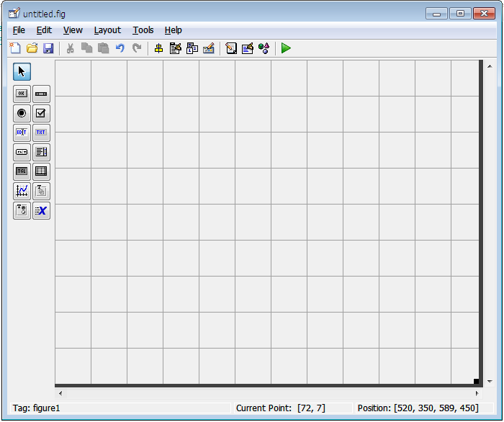
GUI
What is the MATLAB GUI?
GUI = Graphical User Interface
The ability to create a convenient graphical user interface in the MATLAB environment
Creating a GUI
It is recommended to work with GUIDE
Typing the guide command will take us to the environment in which the GUI is designed
An empty GUI look like this:

Slide 26
GUI
How do they work?
The GUI works in parallel with 2 files of the same type:
A .fig file containing the graphic
A .m file containing the code
Every change in one file affects the other
We’ll add graphical objects, define properties, and specify the code they run
The most common call is to a function called callback. The function runs when the user mouse-click the object
Edit the function by right-click on the object $→$ view callbacks
The code works with a variable called handles that contains handles to all the GUI objects.

Slide 27
GUI
Common commands
get – find an object attribute. For example:
set – specifies an attribute of an object. For example:
Common features
get(handles.pushbutton1,’visible’) % 1
set(handles.text1, ’string’ , ‘This is a text box’)
Attribute | What it controls
visible | Whether the object is visible or hidden
string | The text displayed on the object
position | Object size and its position in the window
value | The value associated with this object

